Slide 1
FUNDAMENTALS OF NURSING II
Theory /practicum hours= 22
Module units
The nursing process- 6 hrs theory/ 4 hours practical
Critically ill and the unconscious patients- 10 hrs, theory
Introduction to care study, 2 hours, theory

Slide 2
THE NURSING PROCESS
TEN HOURS

Slide 3
Learning objectives
Define the term nursing process
Outline the purpose of the nursing process
Explain the phases of the nursing process
Outline the application of the nursing process in provision of quality care

Slide 4
Definition
A systematic rational method (client centered) that entails gathering and analyzing data to identify clients’ strength and potentials or actual health problems, develop a plan of nursing interventions to achieve mutually agreed outcomes
Patient/client and nurse work together to provide individualized care

Slide 5
Purpose of the nursing process
To identify a patient/client’s healthstatus and actual/potential health problems, to establish plans to meet the identified needs and to address those needs
The nursing process is cyclical; components follow a logical sequence but more than one component may be involved at one time

Slide 6
Phases of the nursing process
Assessing
The collecting, organizing, validating, and documenting client’s data
Done through nursing health history and physical examination, review of previous records, and consultation with other health professionals
It is continuous and carried out throughout all the phases

Slide 7
Types of assessment
a). Initial assessement
Done within specific time after admission to a health care agency
Used to establish a complete data base for problem identification, reference and future comparison
b). Problem focused assessment
- Used to determine the status of a specific problem identified in earlier assessment, e.g. hourly assessement of patient’s fluid intake and urine output in an oliguric patient

Slide 8
c). Emergency assessment
- Perfomed during any physiologic or psychologic crisis of the client to identify life-threatening problems, e.g first assessment of airway, breathing status and circulation during cardiac arrest

Slide 9
d). Time-lapsed assessment
Performed several months after initial assessment
Used to compare patient’s current status to the baseline data previously obtained
Focuses on patient’s response to health problems

Slide 10
During assessment:
Use all avenues to collect data; history, exam, lab results,
Subjective data- symptoms, apparent only to the patient– pain, itching, nausea,
Objective data- signs– observed by nurse,; pallor, temperature, edema, dehydration, distended abdomen
Primary data- from patient
Secondary data from family members, records etc
Accurately and systematically organize data in the nursing cardex

Slide 11
2. Nursing Diagnosis
Definition- a clinical judgement about individual, family, or community’s response to actual or potential health problems/life processes (NANDA 1990)
Provides basis for selection of nursing interventions to achieve outcomes for which the nurse is accountable

Slide 12
Types of N. Diagnoses
Actual nursing dx
patients’/client’s problem that is present at that time of assessment
Diagnosis is based on presence of associated s/s, e.g. ineffective breathing pattern (patient has dyspnea, flaring of nostrils)
Risk nursing dx/potential
- Clinical judgement that a problem does not exist but the presence of risk factors indicates that a problem is likely to occur unless a nurse intervenes, e.g. in open fracture, there’s risk/potential for infection related to impaired skin integrity (skin breakdown)

Slide 13
Wellness diagnosis
Describes human responses to levels of wellness in an individual, family, or community that have a readiness for enhancement, e.g. readiness for enhanced family coping/readiness for enhanced spiritual well-being

Slide 14
Components of NANDA nursing diagnosis
The problem and its definition (diagnostic label)
Describes the client’s health problem or response for which nursing therapy is given
Directs formation of goals, desired outcomes, and suggests some nursing interventions
Qualifying terms: impaired, deficient, altered, decreased. These are added to the label to give meaning

Slide 15
Etiology (related/risk factors)
Identifies one or more probable causes of the health problem, gives direction to the required nursing therapy and enables the nurse to individualise client’s care
The factors maybe pathophysiologic (disease process), treatment related (restricted mobility/fluid intake), situational (disease chronicity, poor disease prognosis)

Slide 16
Defining characteristics
Clusters of signs and symptoms presented by the patient that indicate the presence of a particular diagnostic label
Applicable only in actual nursing diagnoses
== example:
Label– imbalanced nutrition less than body requirement
Etiology– related to inability to chew/swallow food
Defining characteristics– as evidenced by MUAC less than 12/weight loss/muscle wasting

Slide 17
3. Planning
A deliberative, systematic phase that involves decision making and problem solving
The nurse refers to the assessment data and diagnostic statements for directions in formulating client’s goals and designing the nursing interventions required to prevent, reduce, or eliminate the existing health problem
Patient/significant others should be involved in planning
End result of planning is client care plan

Slide 18
Types of planning
Initial planning
Done on admission after the initial assessment. Direct information is taken from the client other than the written data
2. Ongoing planning
- Done by all nurse who work with the client. Based on new information obtained and evaluation of patient’s response to the initiated nursing care

Slide 19
3. Discharge planning
The process of anticipating and planning for patient’s needs after discharge
Effective planning begins at first client contact qand involves comprehensive and ongoing assessment to obtain information about the patient’ s ongoing needs (knowledge on home care, health maintenance, drug compliance).

Slide 20
The planning process
It has 4 steps:
i- setting priorities- establish preferred sequence for addressing nursing diagnoses and interventions; from high life threatening), medium (health threatening) to low priority
ii- establishing clients goals/desired outcomes. Goals are statements about client’s status. d/outcomes evaluate whether the goals have been met
Goal-improved nutritional status
Desired outcome- gain 2 kgs by April 20th

Slide 21
Goals/outcome
Provide direction for planning nursing interventions
Serve as criteria for evaluation client progress and judging interventions in the evaluation step
May be long/short term

Slide 22
iii- selecting n/interventions and activities
Actions that a nurse performs to achieve client’s goals
Choices should aim at elimination/reduction of the etiology in the nursing diagnosis
Can be independent (nurse initiated based on own knowledge and skills), dependent (carried out under physician’s orders/specified routines), collaborative (in collaboration with other h/c/workers

Slide 23
iv- writing individualized n/intervention
Are dated on the nursing care plan when they are written and reviewed regularly at intervals that depend on the client’s needs
Should be signed for accountability and legal significance

Slide 24
4. Implementation
- The action phase in which nurse performs the nursing interventions
Involves doing and documenting activities that are specific nursing actions which were developed in the planning phase
Assessment continues during implementation and possible re-planning prn. An implementation can as well be accompanied by assessment, e.g. bed bath of an elderly client with assessment/observing for pressure ulcers
An intervention should be recorded immediately after implementation to safeguard client, e.g. double medication

Slide 25
5. Evaluation
A planned ongoing purposeful activity in which clients and h/care workers determine:
Clint’s progress towards achieving the goals/desired outcomes
Effectiveness of the nursing care plan
Conclusions drawn from the evaluation determine whether nursing interventions should be terminated, continued or changed
Evaluations are continuous, done until the client achieves health goals and is discharged from nursing care

Slide 28
MANAGEMENT OF CRITICALLY ILL /UNCONSCIOUS PATIENTS
Learning objectives:
Definitions
Categories and levels of critically ill patients
Assessment of a critically ill patient (GCS and AVPU)
Management of critically ill/unconscious patient

Slide 29
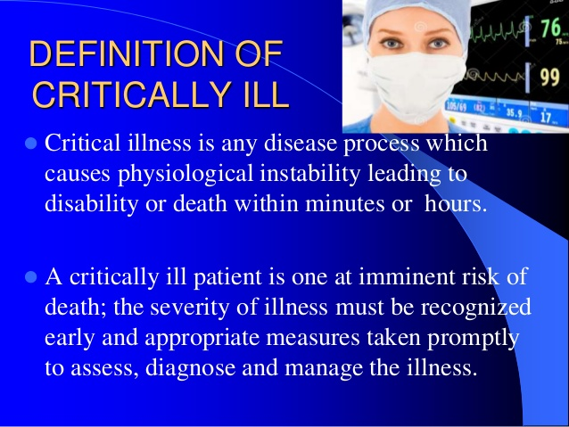

Slide 30
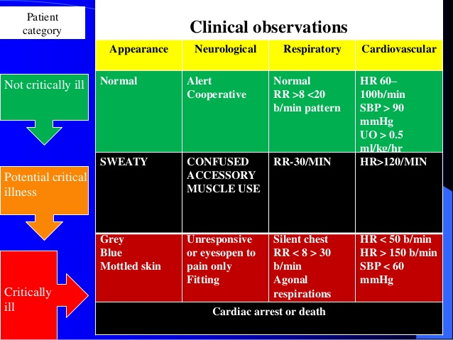

Slide 31
Critical care- introduction
Critical care nursing: the field of nursing with a focus on the utmost care of the critically ill/unstable patients
Critically ill patients: patients at risk for actual or potential life threatening health problems
Critical care units:- CCUs/ICUs are designed to meet the special needs of acutely and critically ill patients

Slide 32
What are the conditions considered as critical?
All life threatening conditions:
Acute respiratory failure
Acute myocardial infarction
Cardiac tamponade
Severe shock
Acute renal failure
Poly trauma
Multiple organ failure
Organ dysfunction
Severe burns

Slide 33
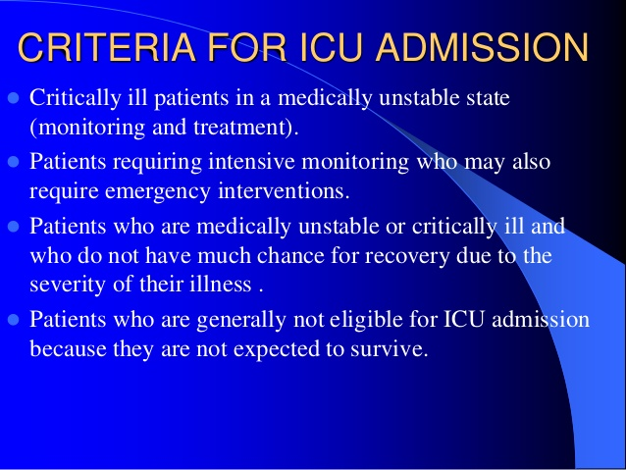

Slide 34
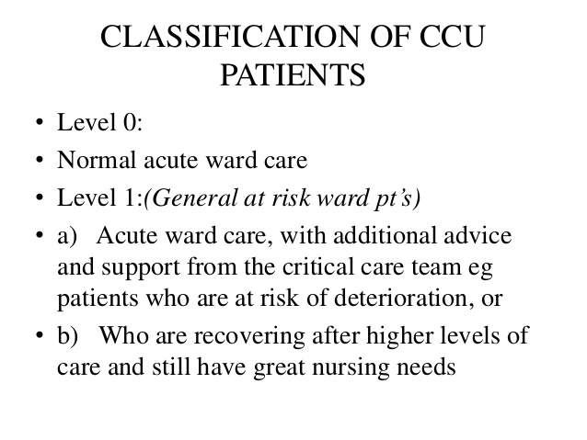

Slide 35
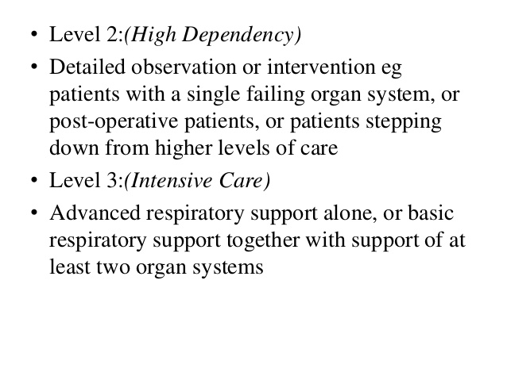

Slide 36
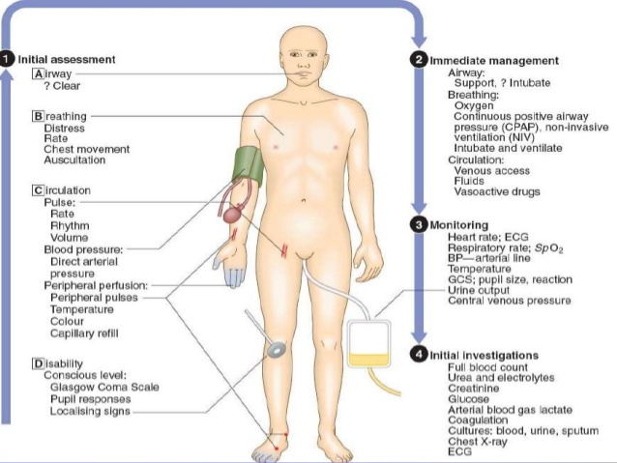

Slide 37
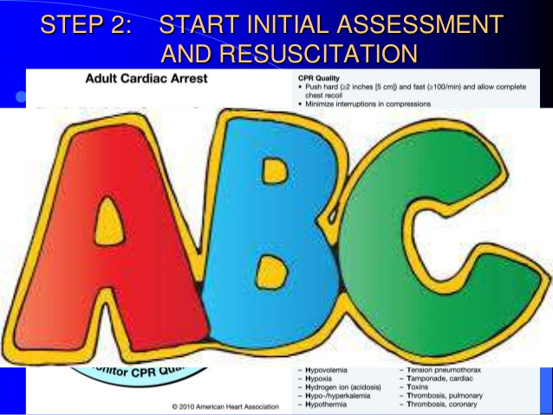

Slide 38
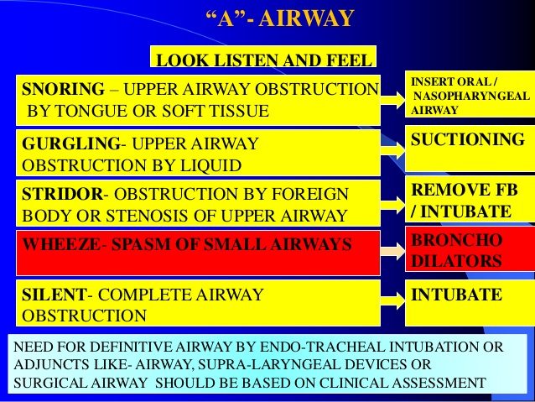

Slide 39
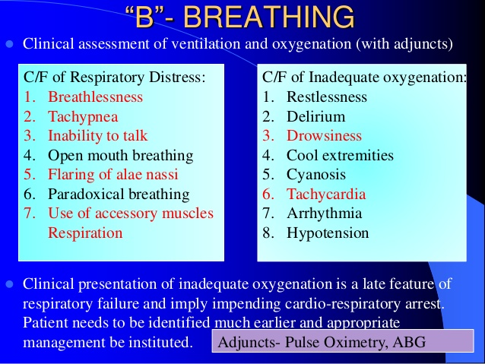

Slide 40
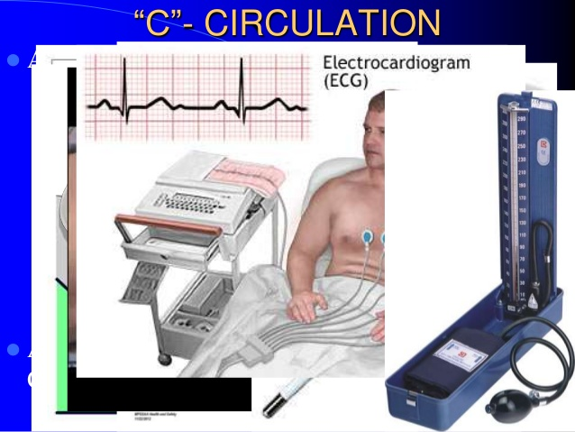

Slide 41
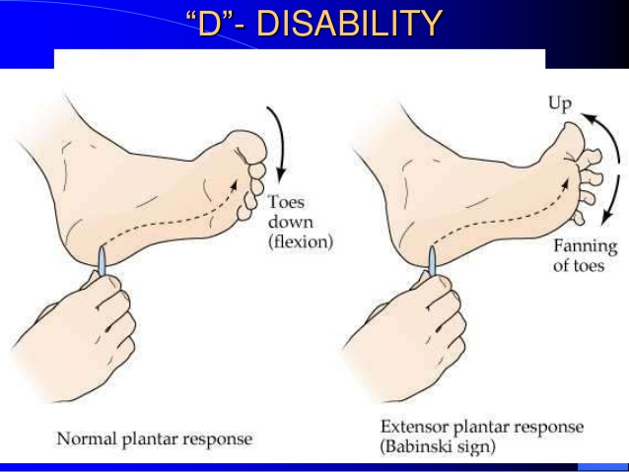

Slide 42
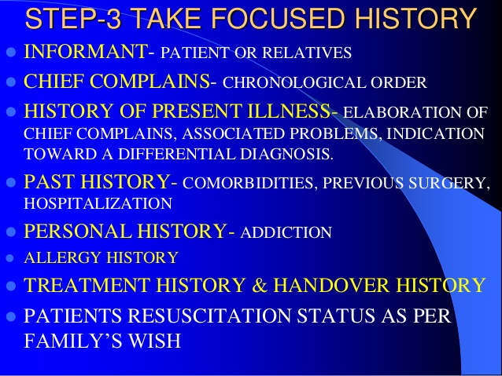

Slide 43
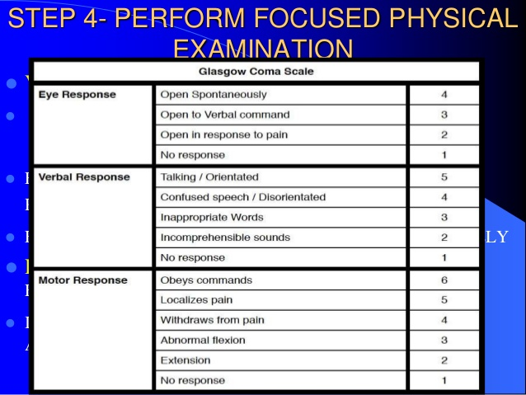

Slide 44
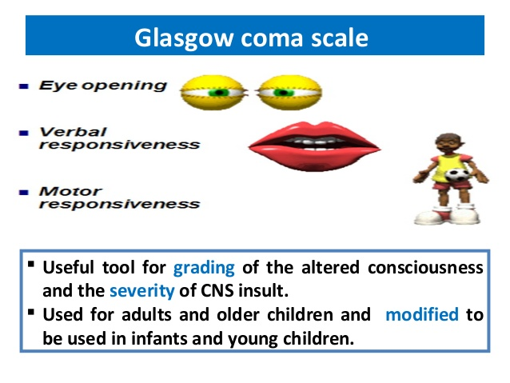

Slide 45
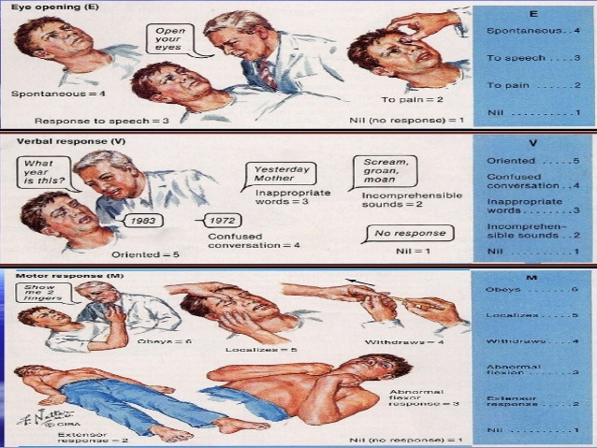

Slide 46
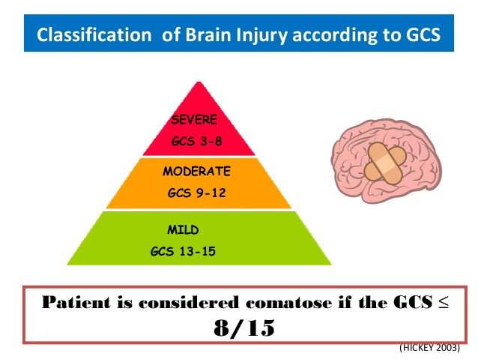

Slide 47
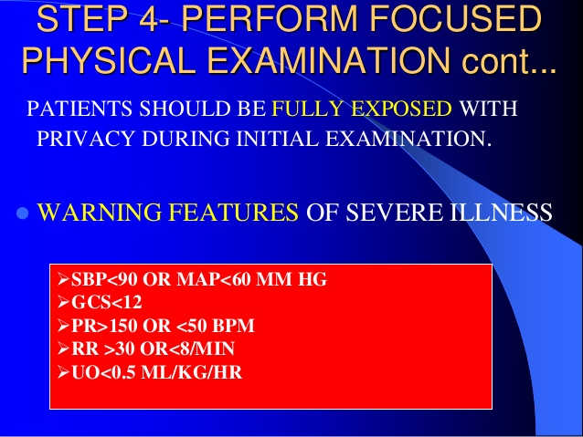

Slide 48
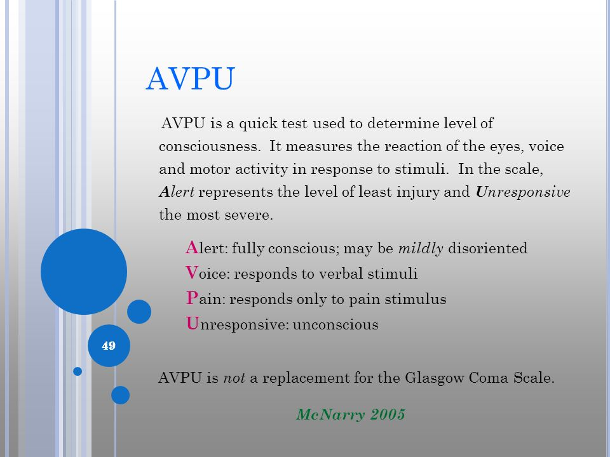

Slide 49
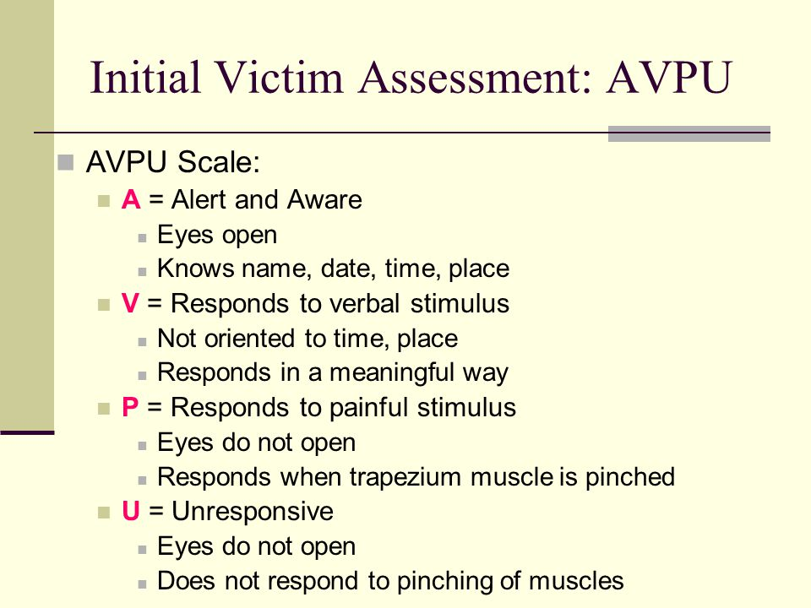

Slide 50
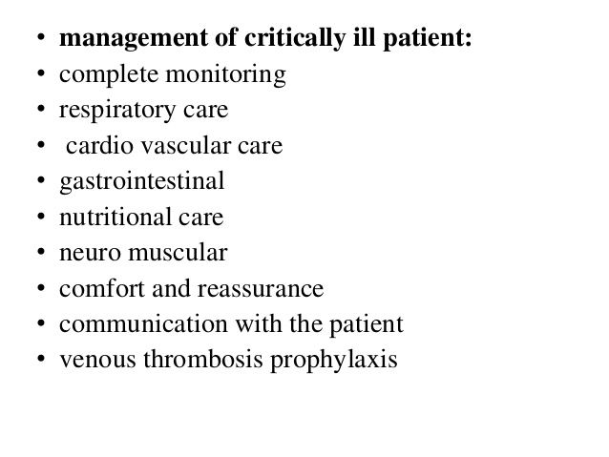

Slide 51
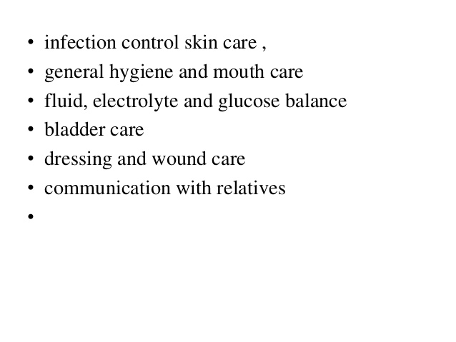

Slide 52
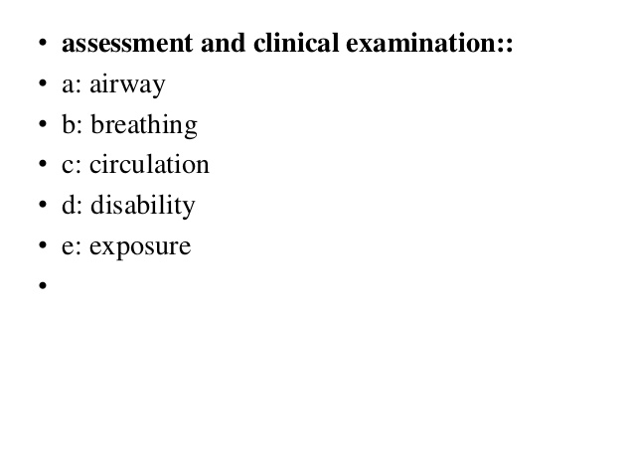

Slide 53
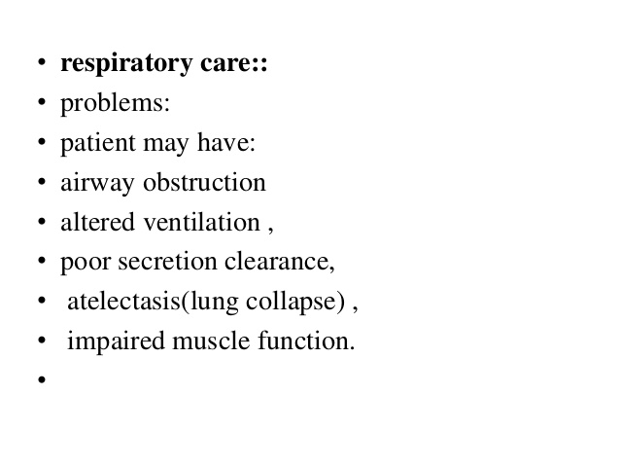

Slide 54
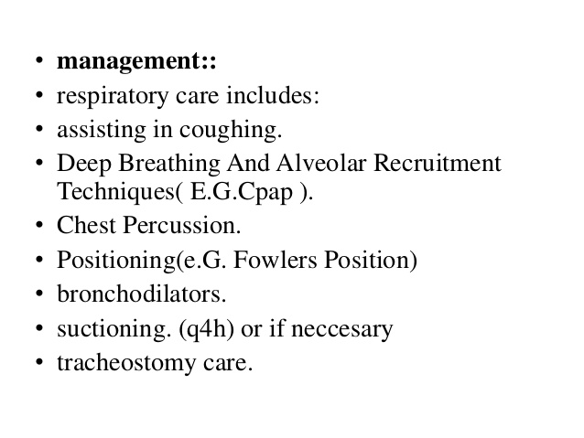

Slide 55
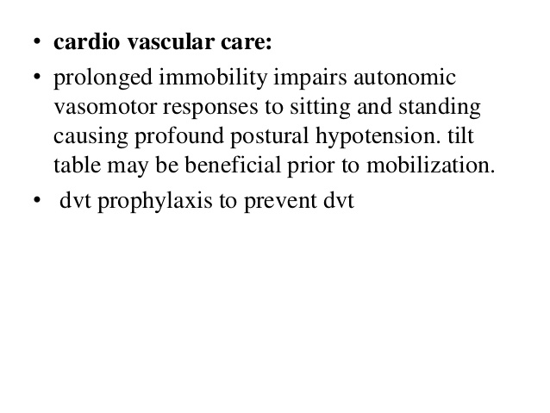

Slide 56
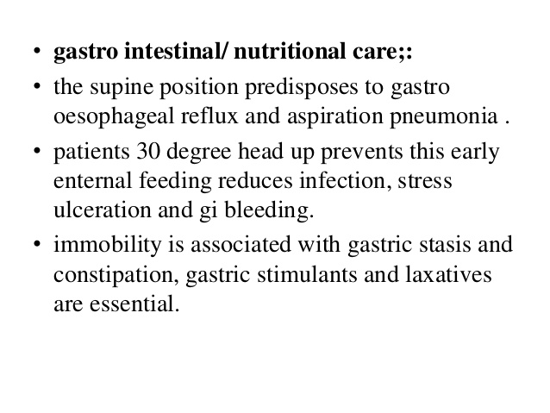

Slide 57
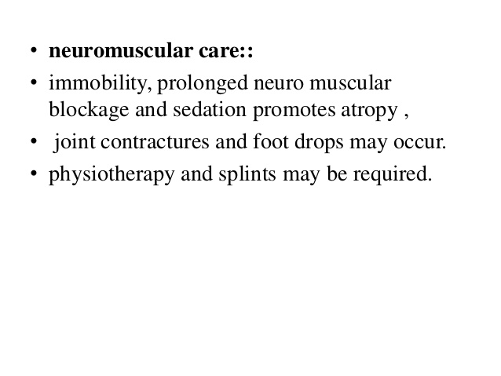

Slide 58
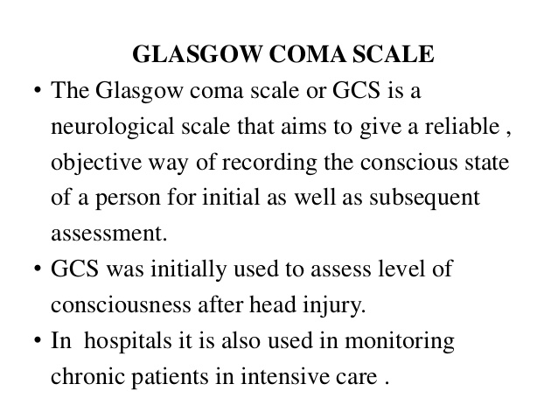
Assessment of the patient

Slide 59
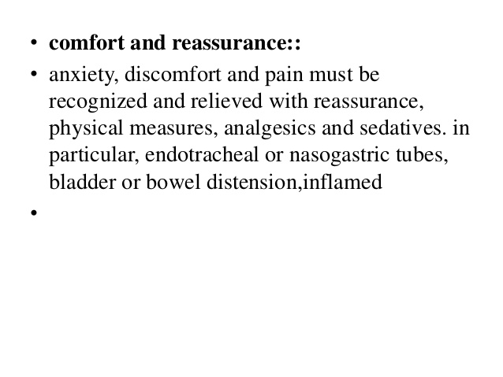

Slide 60
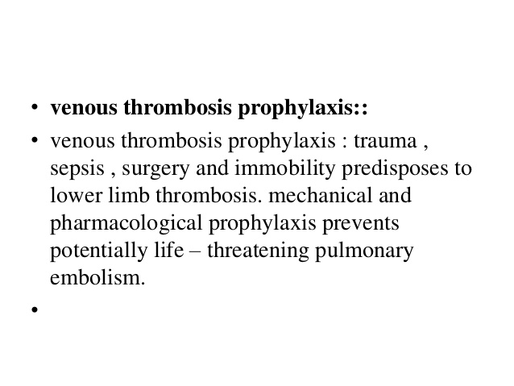

Slide 61
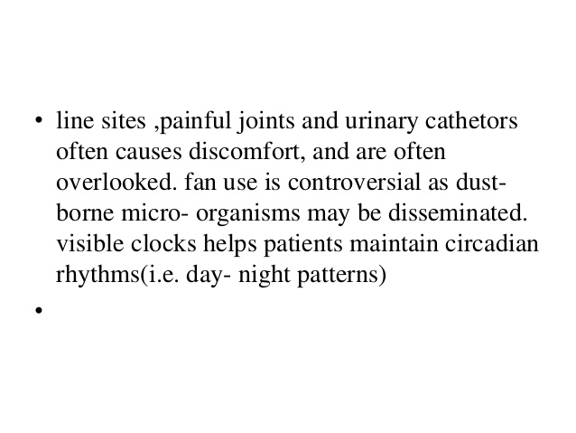

Slide 62
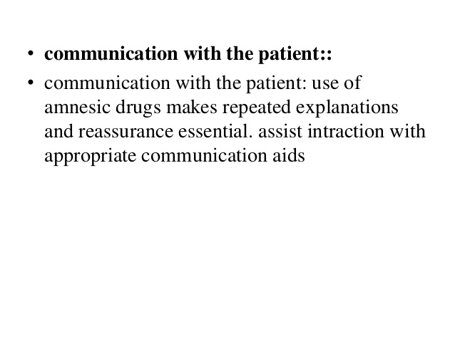

Slide 63
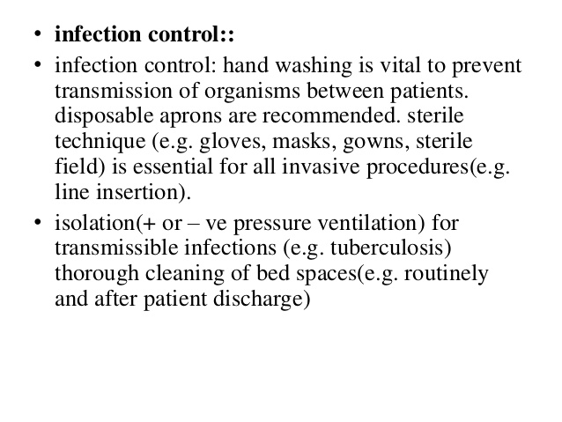

Slide 64
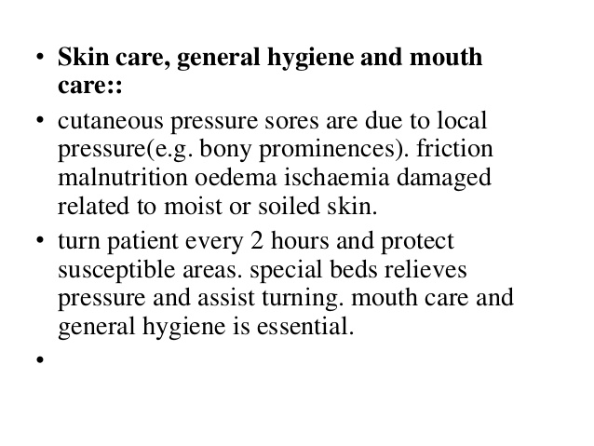

Slide 65
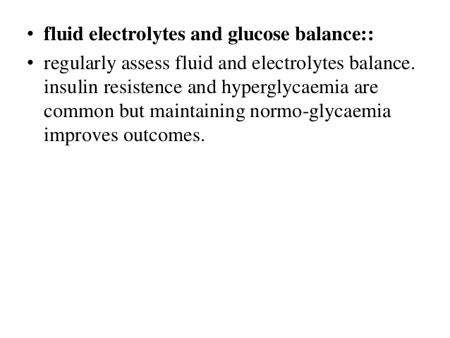

Slide 66
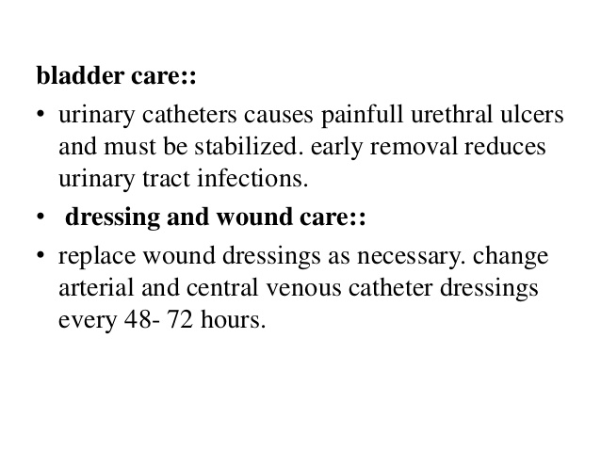

Slide 67
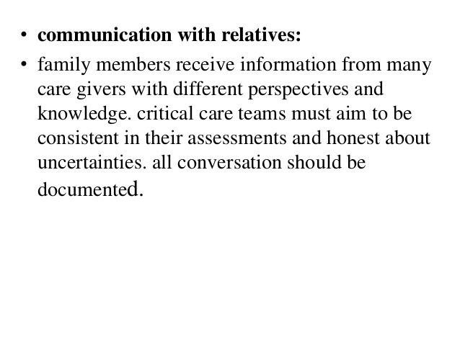

Slide 68
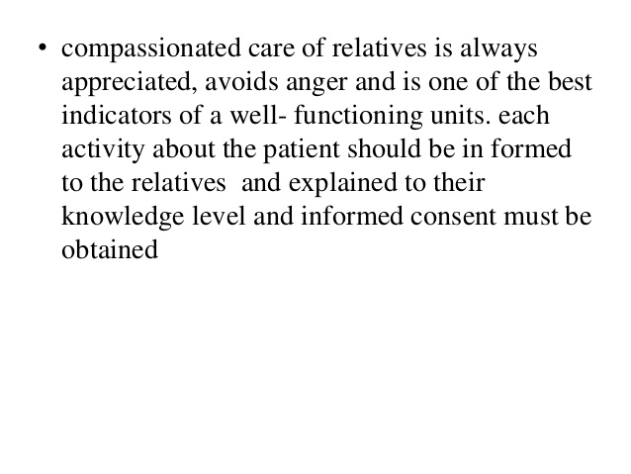

Slide 69
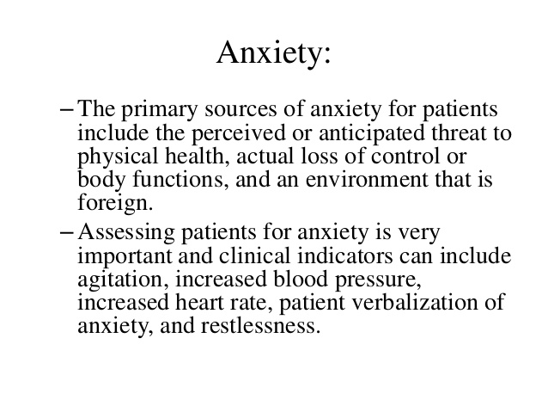

Slide 70
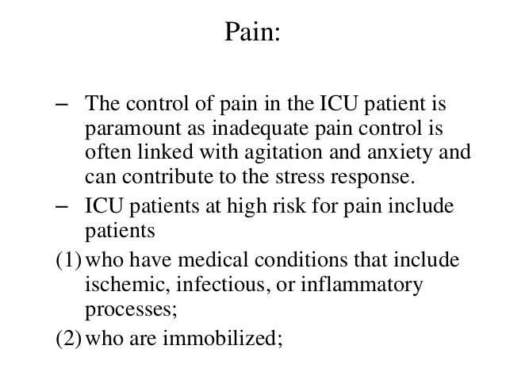

Slide 71
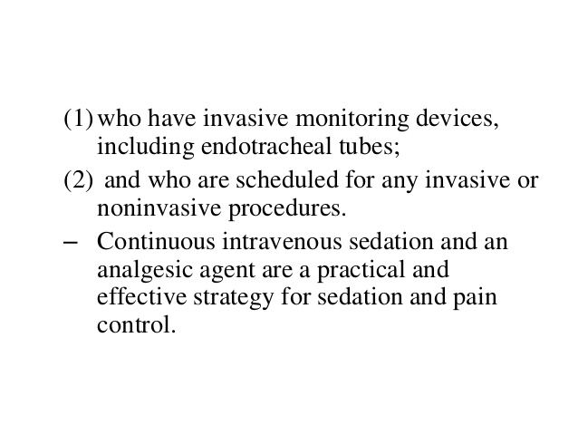

Slide 72
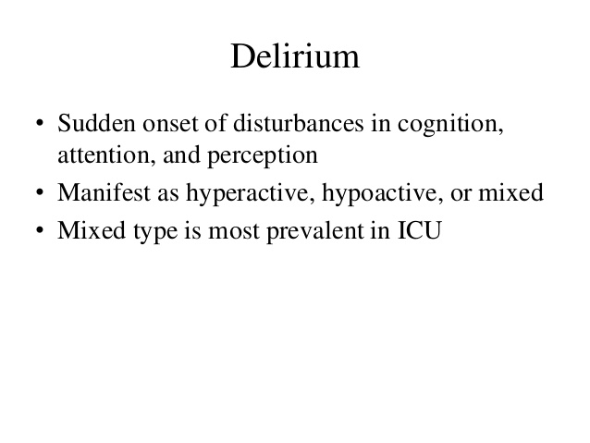

Slide 73
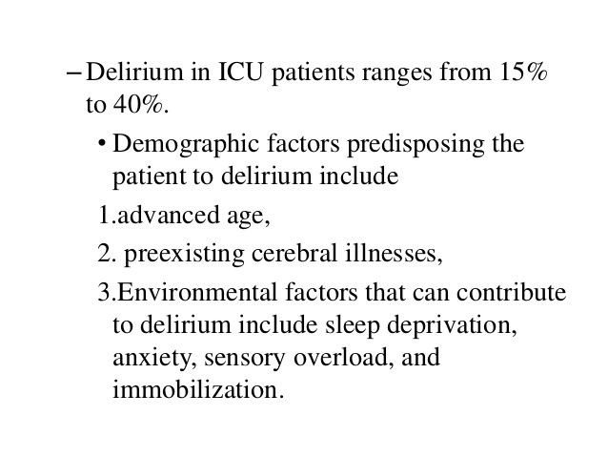

Slide 74
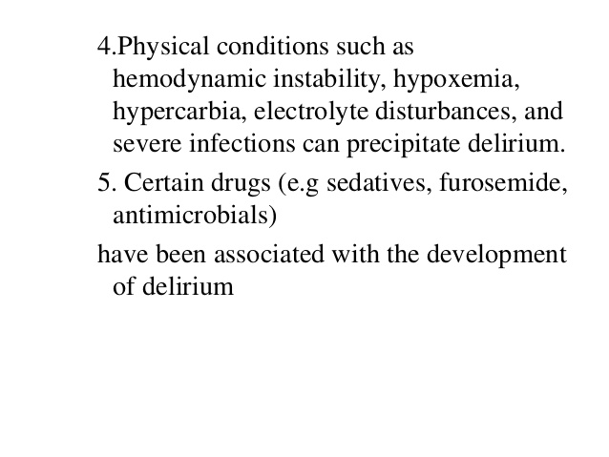

Slide 75
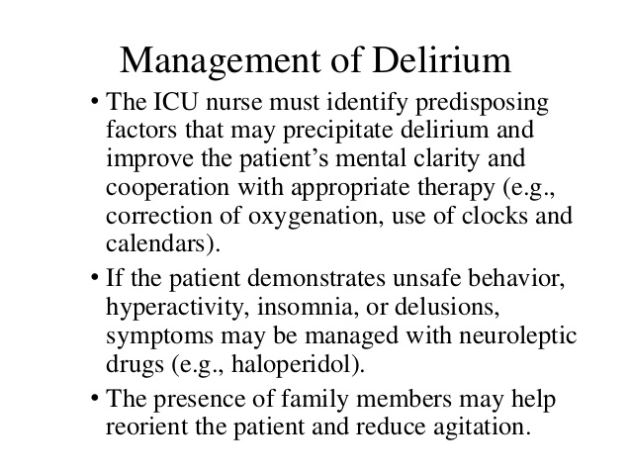

Slide 76
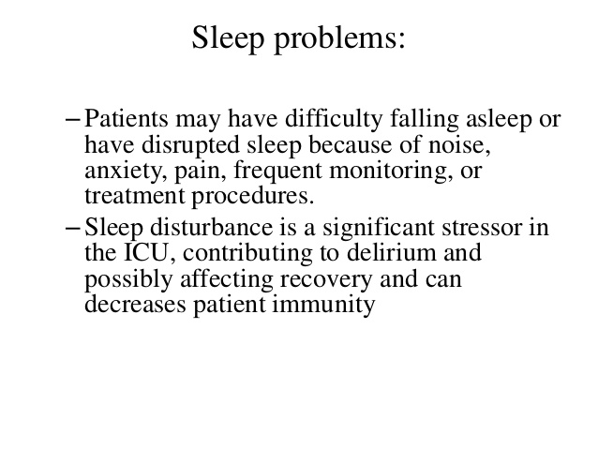

Slide 77
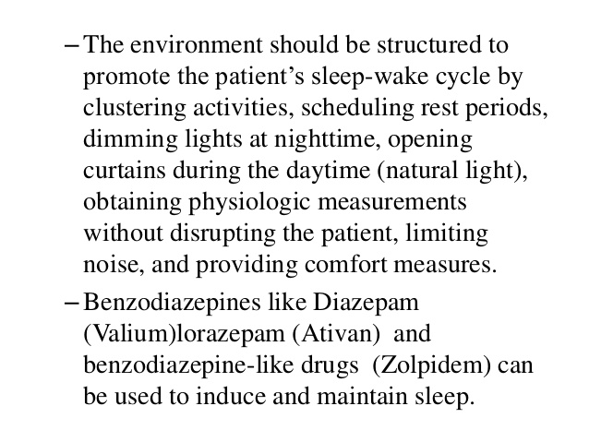

Slide 78
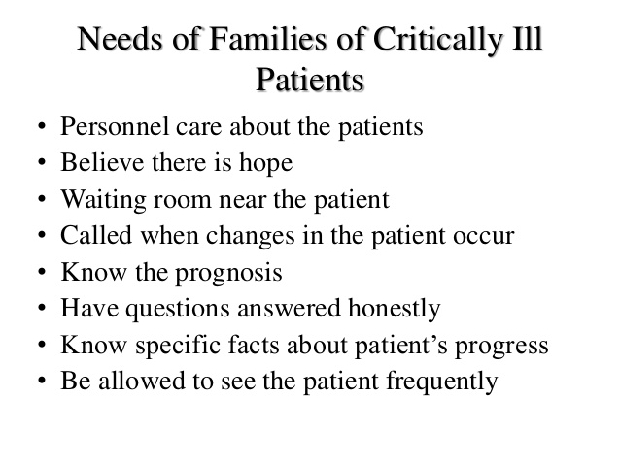

Slide 79
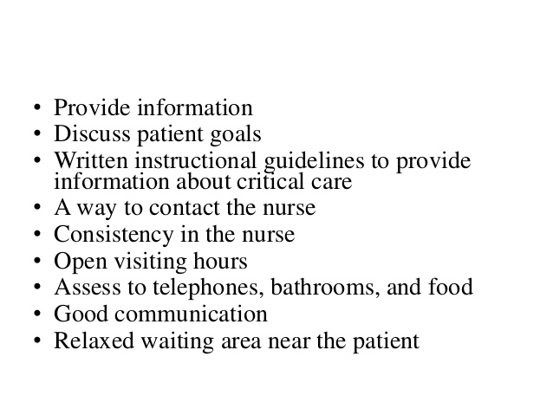

Slide 80


